Slide 1
PhonePe Transaction
Insights
By R.Boneys Dharan
AIML-MAE3 Batch

Slide 2
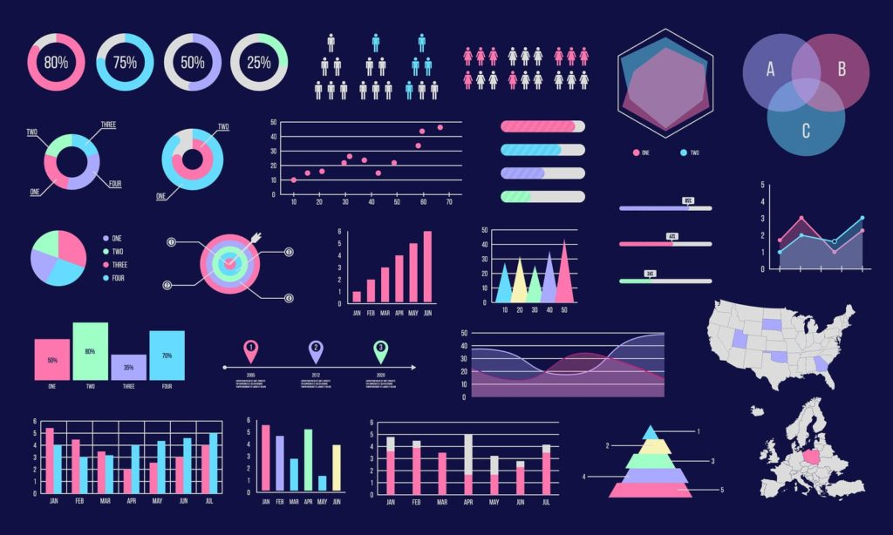
Problem Statement:
With the increasing reliance on digital payment systems like PhonePe, understanding the dynamics of transactions, user engagement, and insurance-related data is crucial for improving services and targeting users effectively. This project aims to analyze and visualize aggregated values of payment categories, create maps for total values at state level and analyze top performers at state level.
Business Use Cases:
Customer Segmentation
Geographical Insights
Payment Performance
Insurance Insights
Trend Analysis

Slide 3

Objective: To explore PhonePe data across states in India and gain valuable insights from visualization of data for the following cases
Device Domination and User Engagement Analysis
Insurance Penetration and Growth Potential Analysis
Decoding Transaction Dynamics on PhonePe
User Engagement and Growth Strategy
Transaction Analysis for Market Expansion
Insurance Engagement Analysis

Slide 4

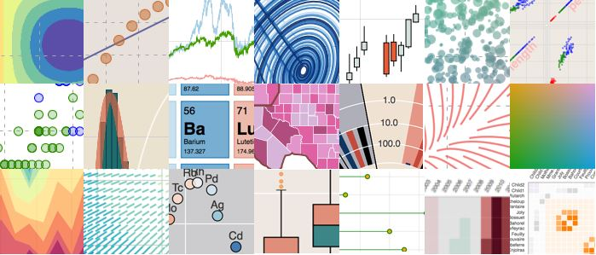
Concepts Used:
Python
MySQL
Data Visualization
Data Extraction
Streamlit
Libraries Used:
Pandas
Streamlit
Json
OS
MySQL
Sklearn
Plotly
Software Tools Used:
Visual Studio Code
MySQL workbench(optional)

Slide 5
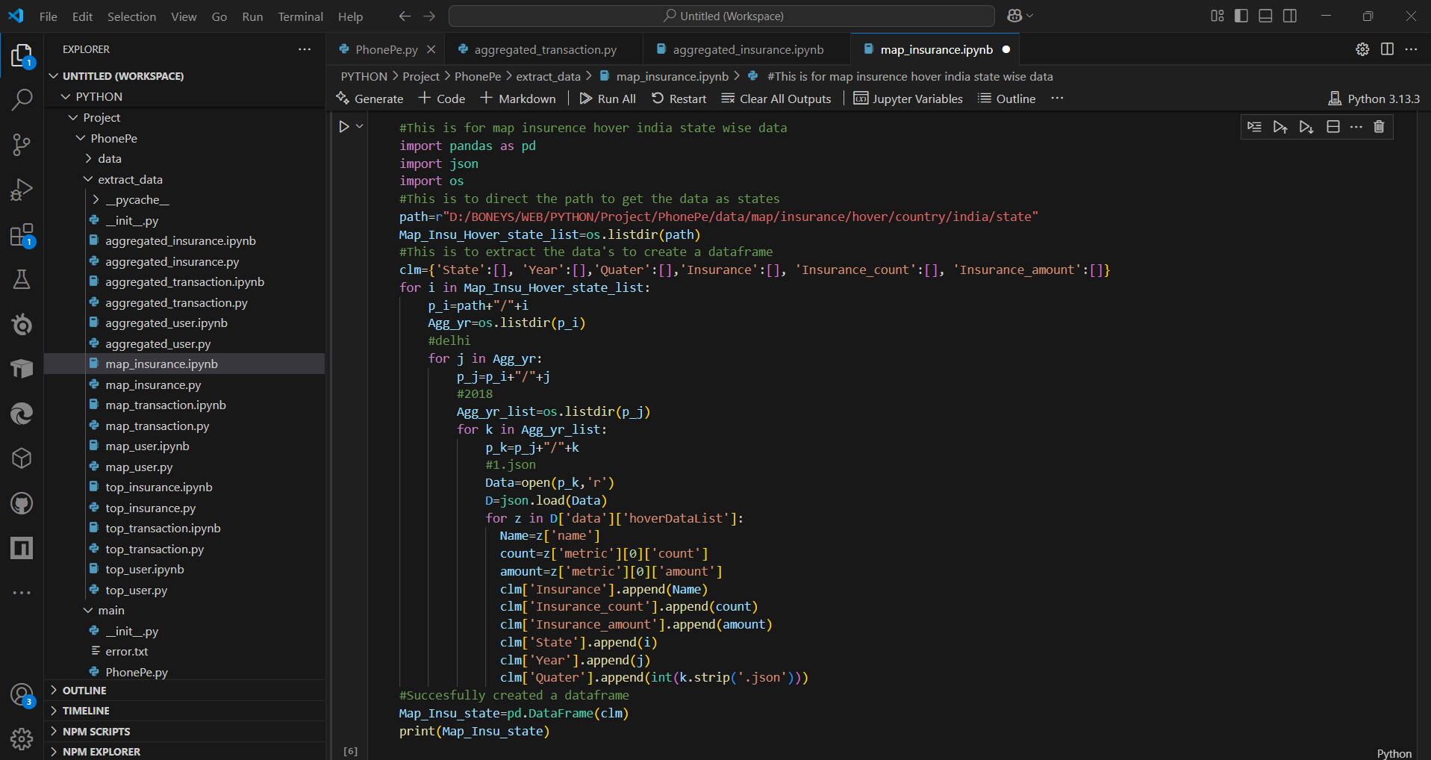
Data Extraction:

Slide 6
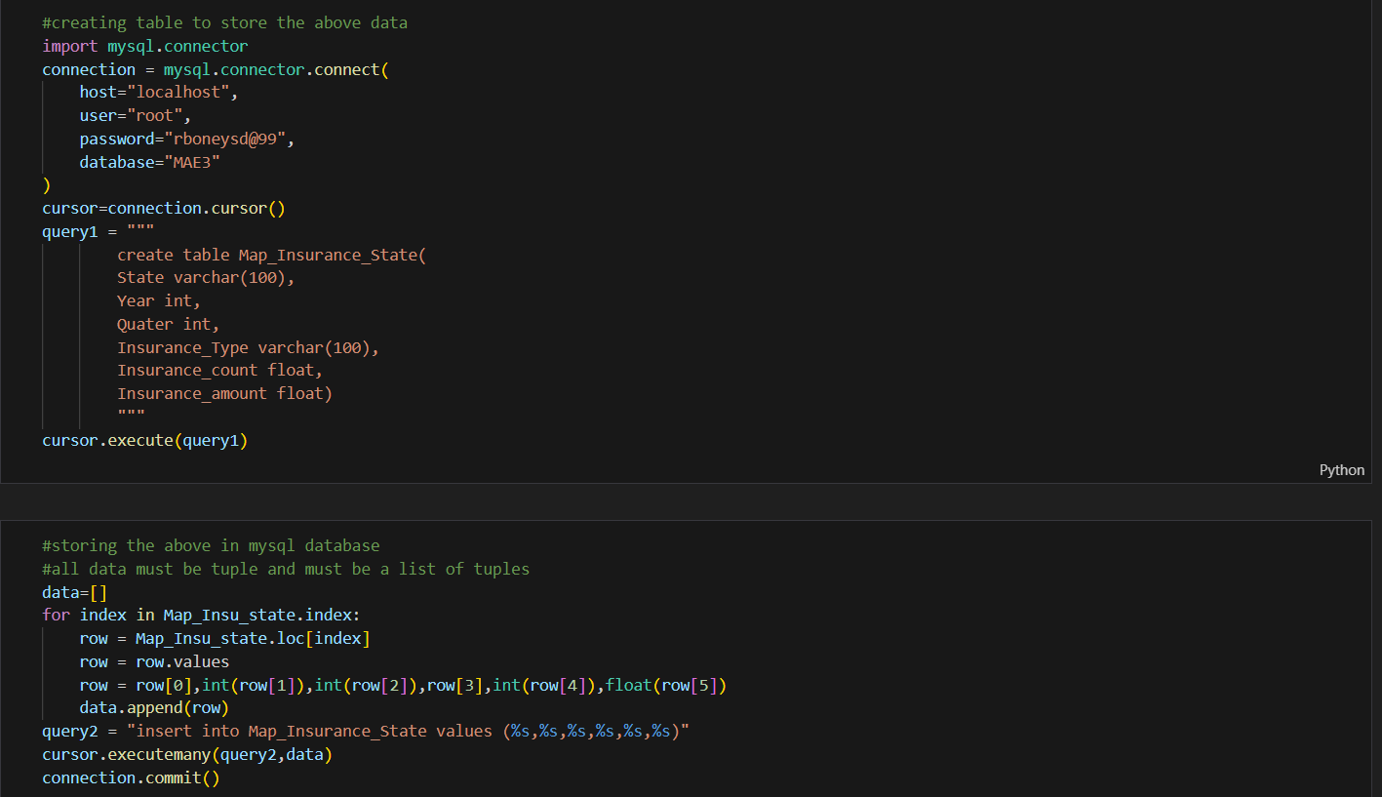
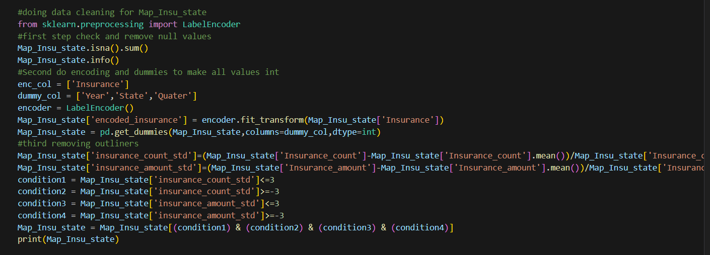
Storing in MySQL and Cleaning Data:

Slide 7
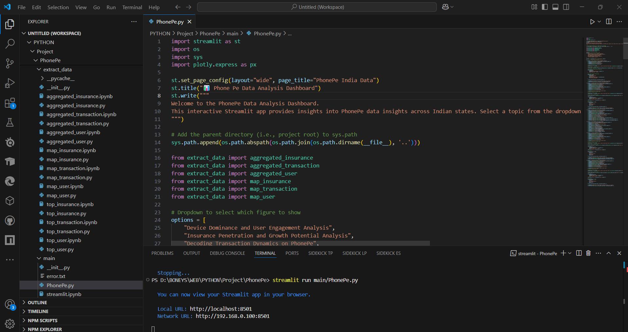
Data Visualization:

Slide 8
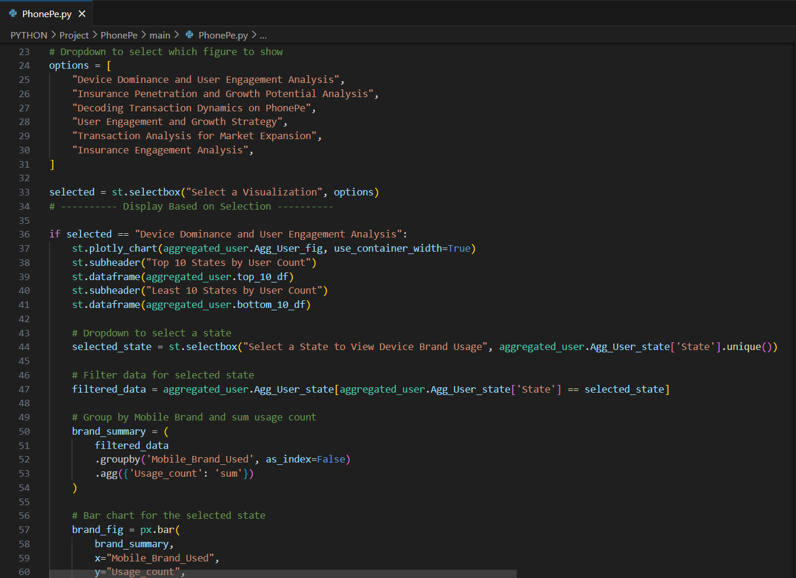
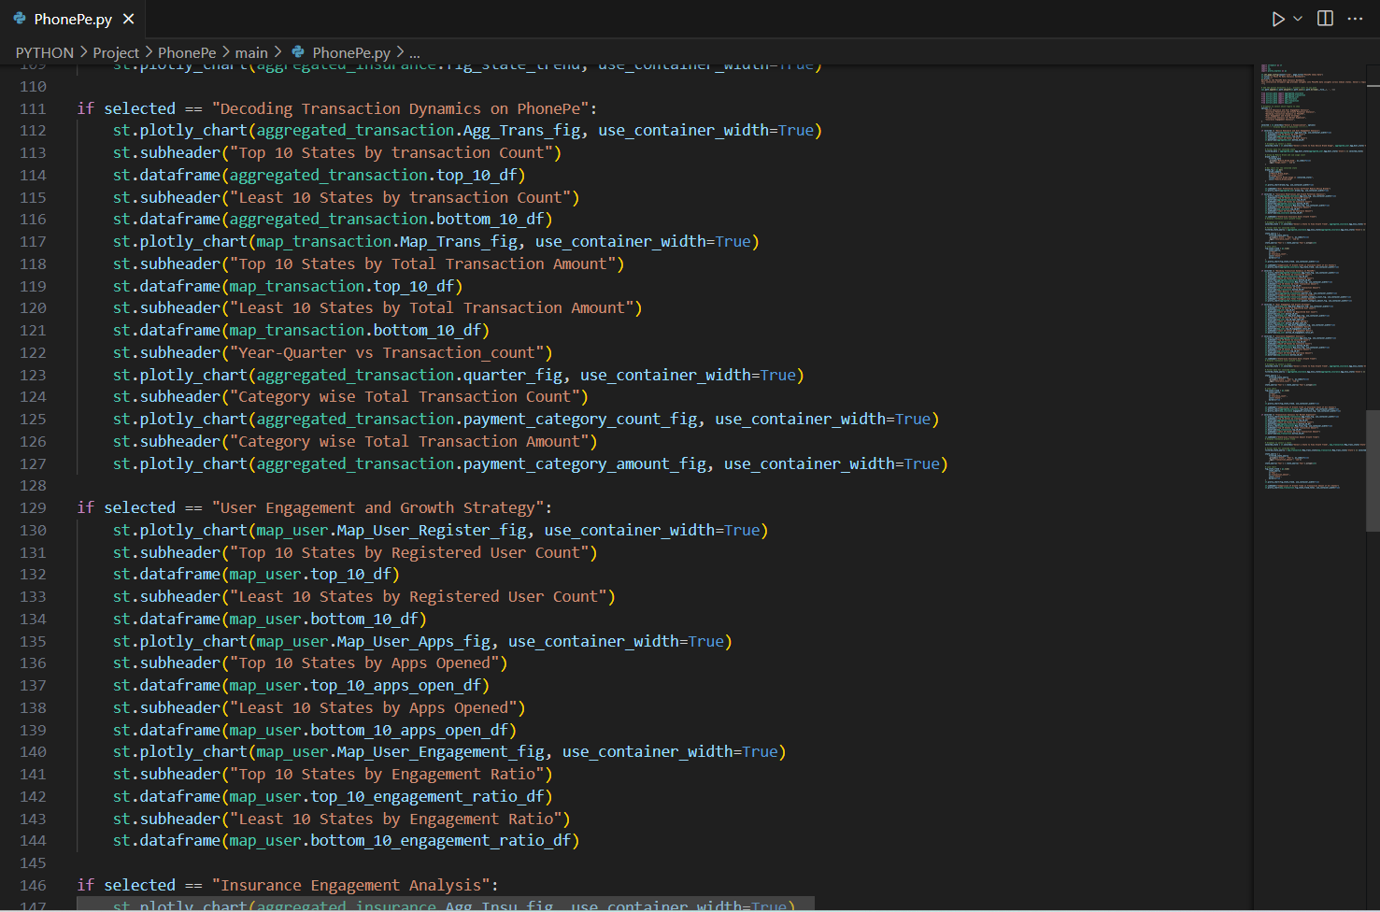

Slide 9
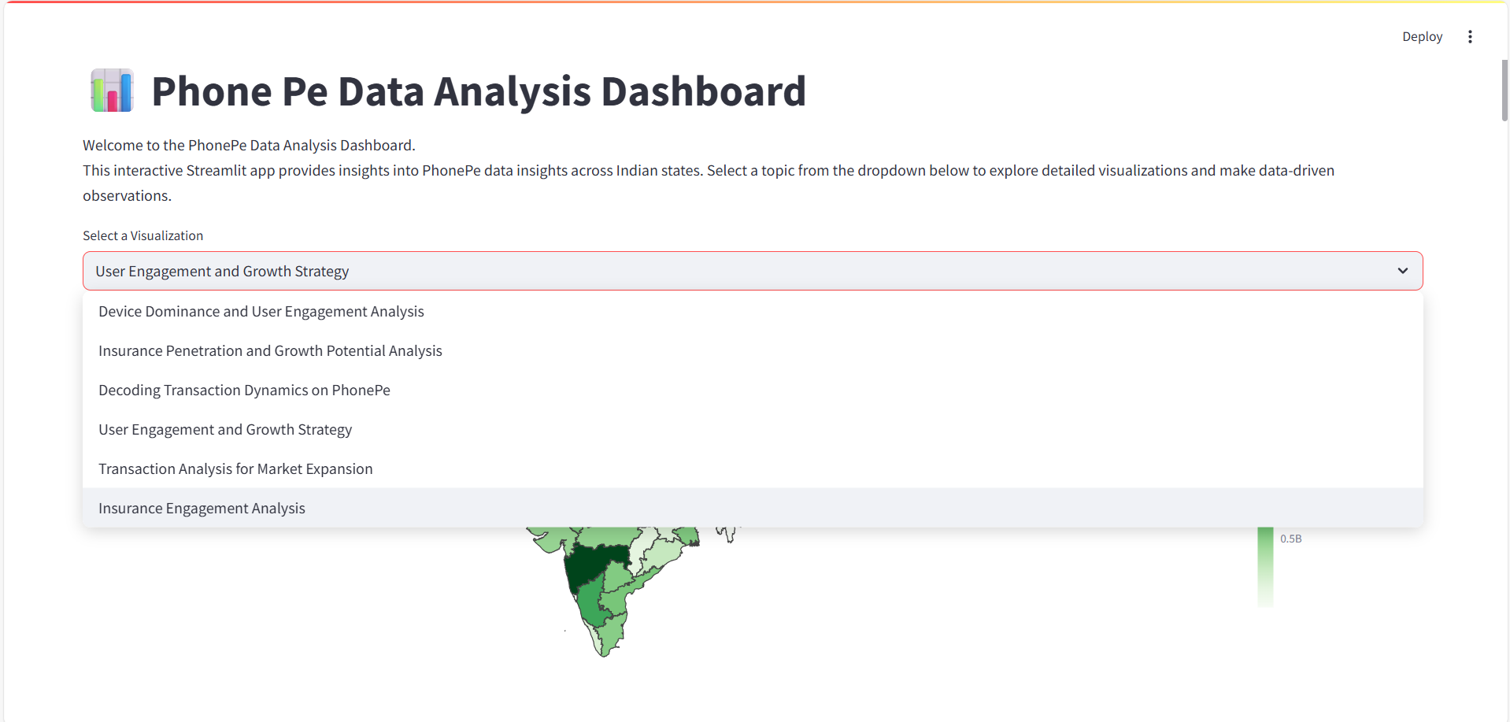
Result:

Slide 10
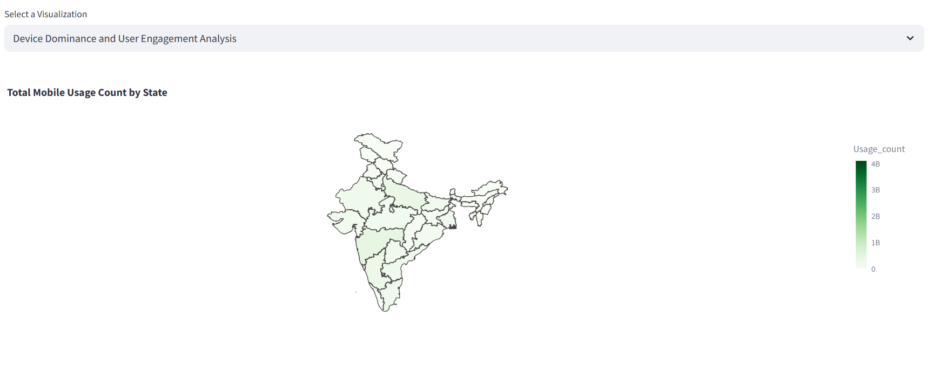
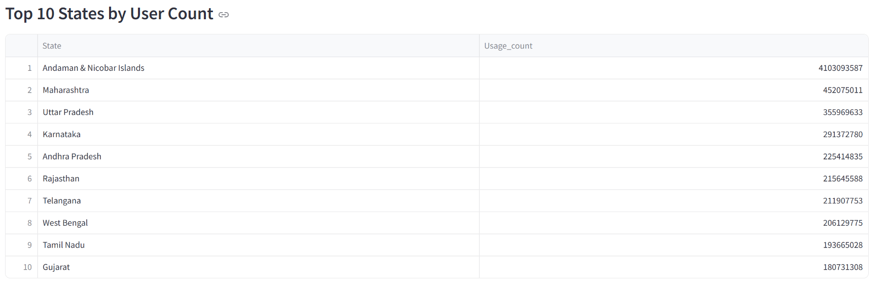
Device Domination and User Engagement Analysis:

Slide 11
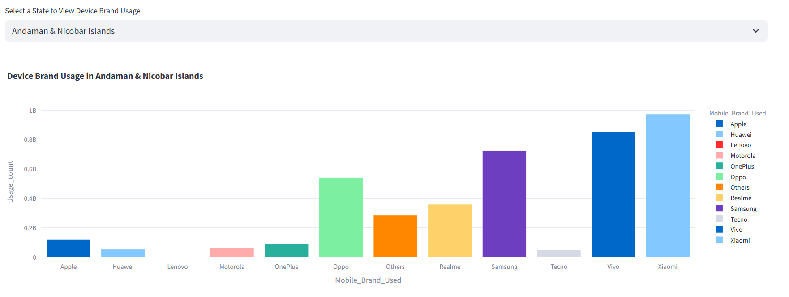
Insights:
Variation of usage of mobile devices across states.
There is a trend in device usage, with Xiaomi leading.
Apple, Huawei, and OnePlus have relatively fewer app opens despite a decent number of registered users.

Slide 12
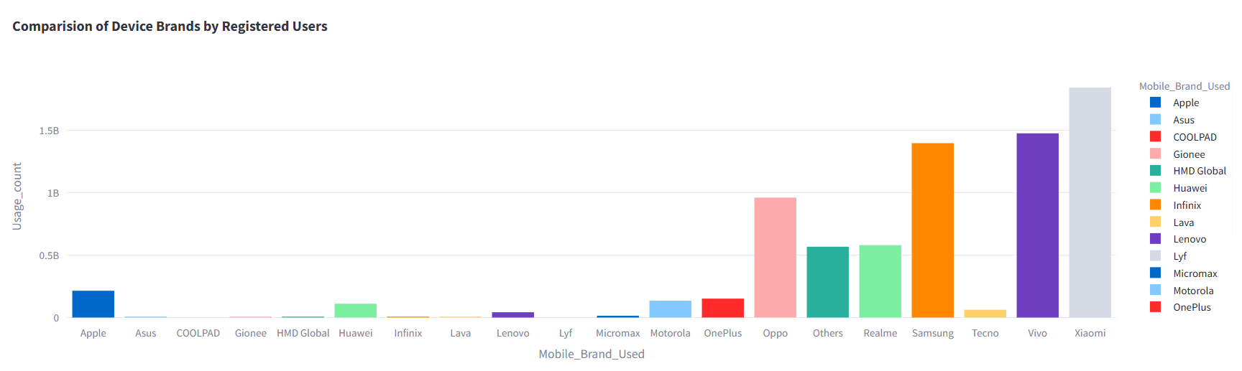
Actions:
Optimize performance on Apple, Huawei, and long-tail devices and enrich UI to attract users.
Run localized UPI awareness campaigns in low-engagement states like Assam, Meghalaya.
Enable more regional language support.
Partner with OEMs (Xiaomi, Samsung, etc.) for pre-installation & bundled offers to reap benefits.

Slide 13
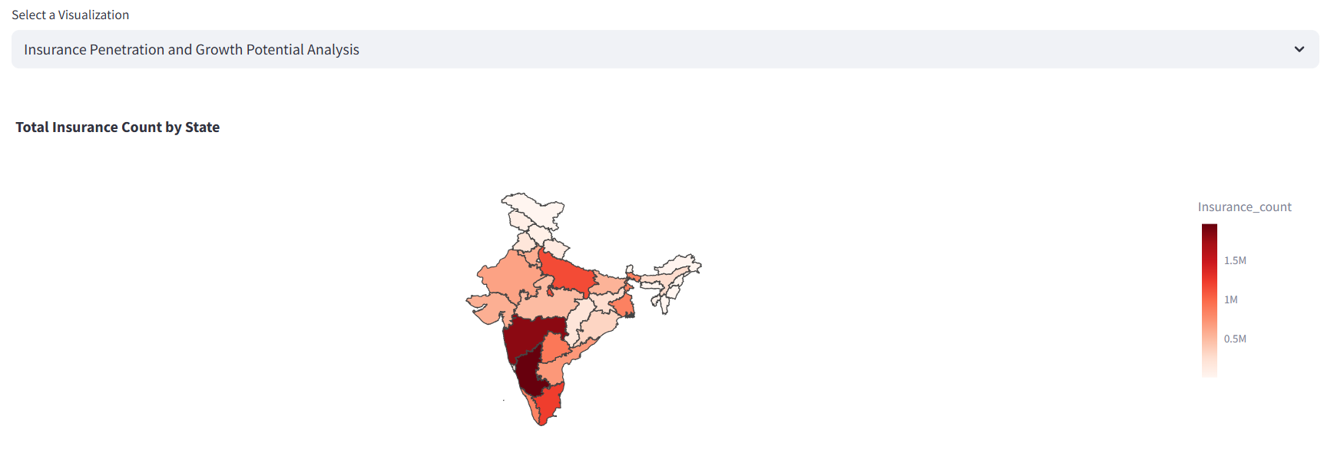
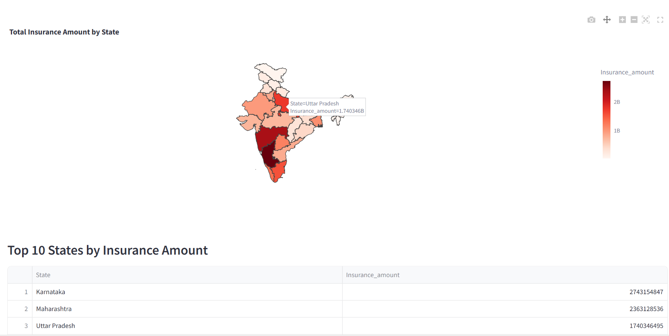
Insurance Penetration and Growth Potential Analysis:

Slide 14
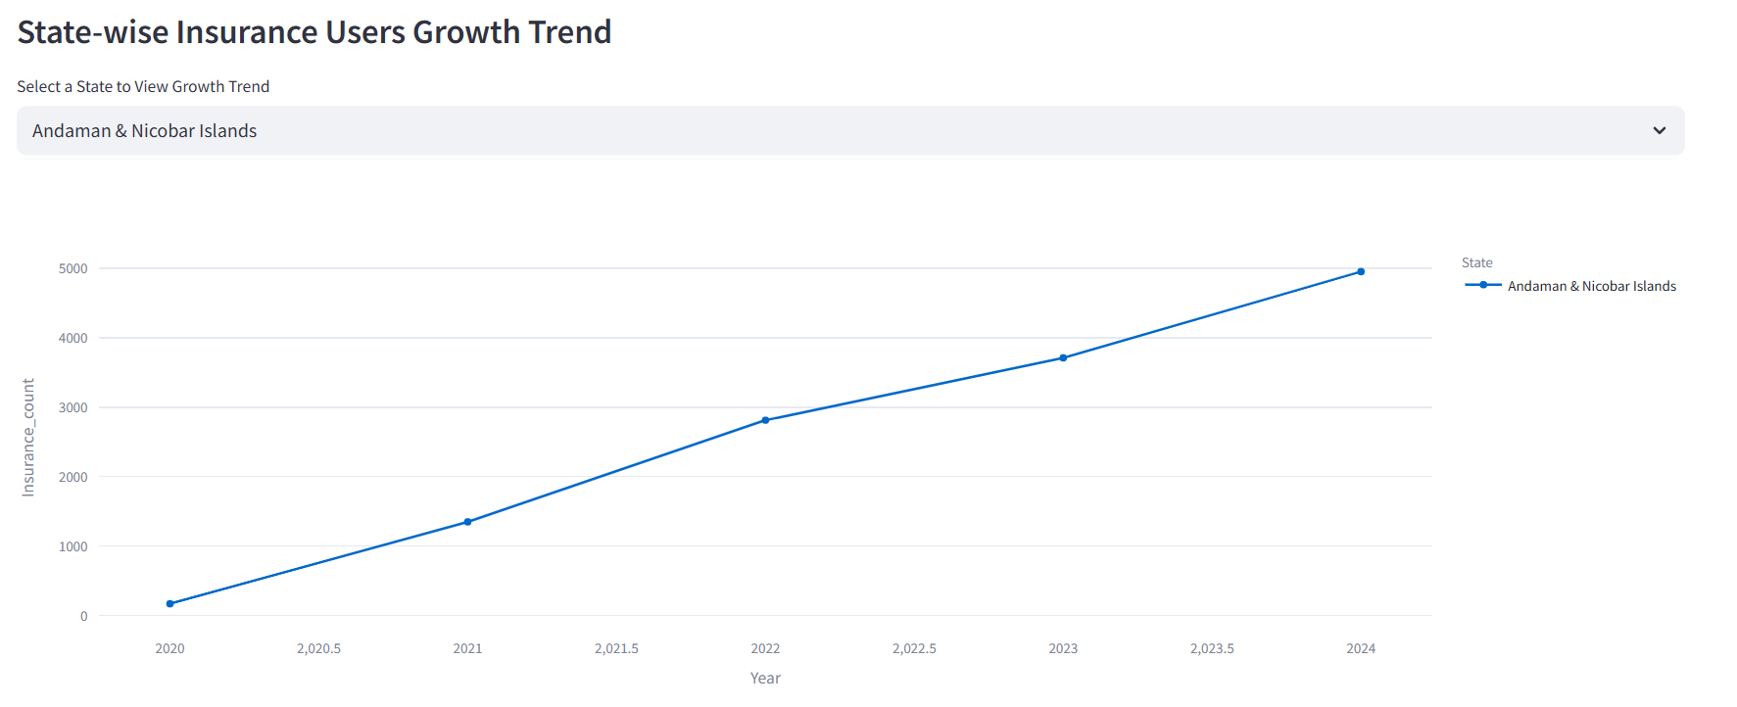
Insights:
Variation of users opting insurance and amount people invest in insurance policies devices across states.
Can view state wise growth of user opting for insurance, with low and highs.
Comparison of growth of user opting insurance, helps in understanding where to proceed with new plans.

Slide 15
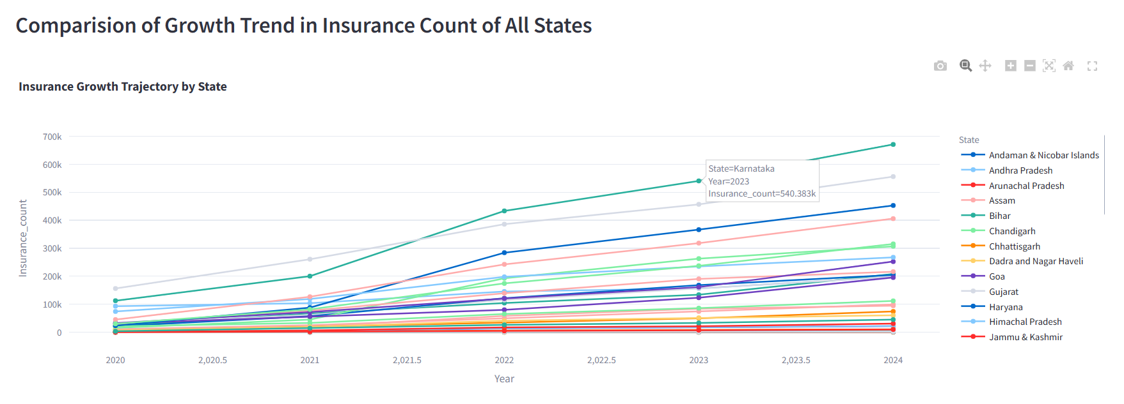
Action:
Use videos, influencers, and community groups to drive awareness for underperforming states.
Offer more insurance options at low costs when availing PhonePe services.

Slide 16
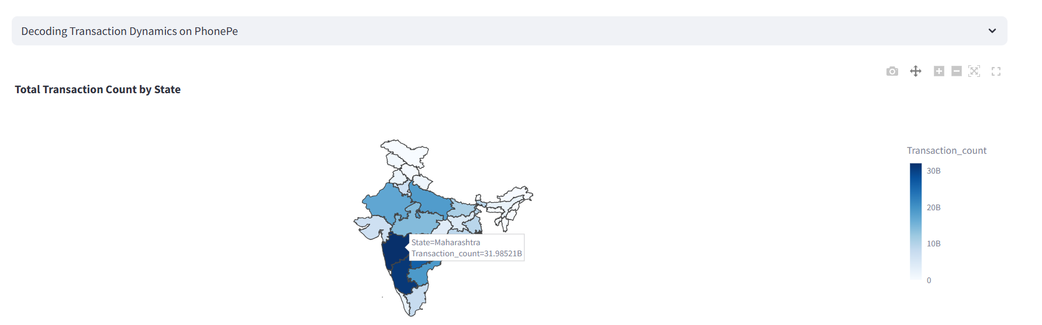
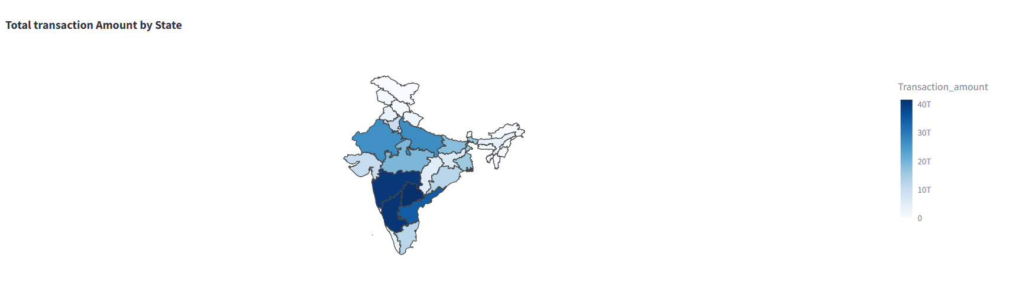
Decoding Transaction Dynamics on PhonePe:

Slide 17
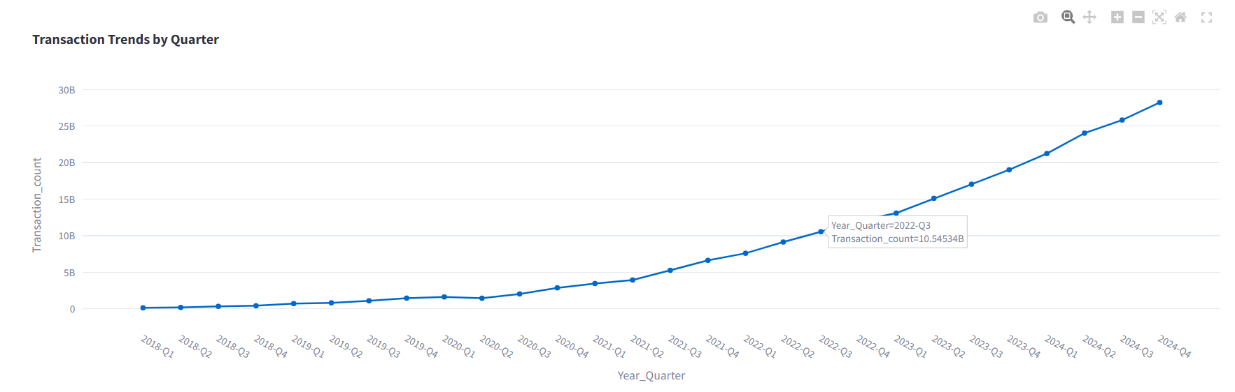
Insights:
Variation of user’s transaction count and transaction amount across states.
Visualize number of transactions taking place with respect to year, with steady rise after 2020-Q4 term.
Can see dominance by Merchant and Peer to Peer transactions, be in payments or in usage, suggesting users needs.

Slide 18
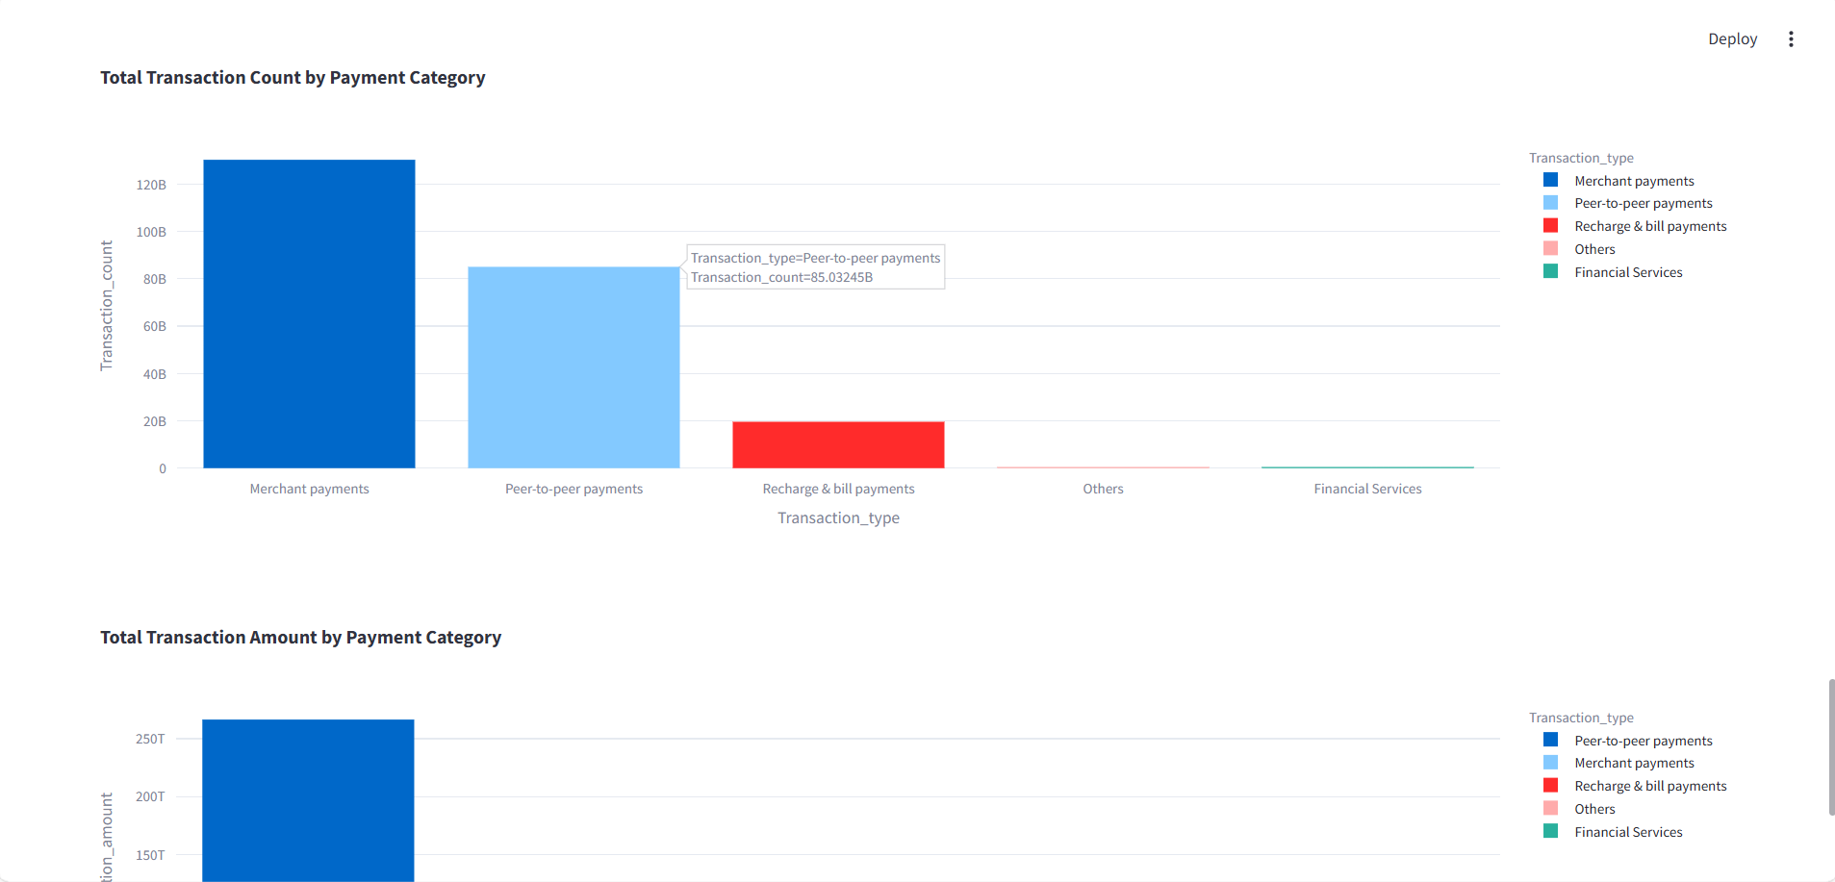
Action:
Partner with local banks/co-operatives to build trust.
Provide special discounts and cashbacks on Merchant and Peer-To-Peer Transactions.
Bundle recharges + bill payments with auto-reminders and combo discounts.

Slide 19
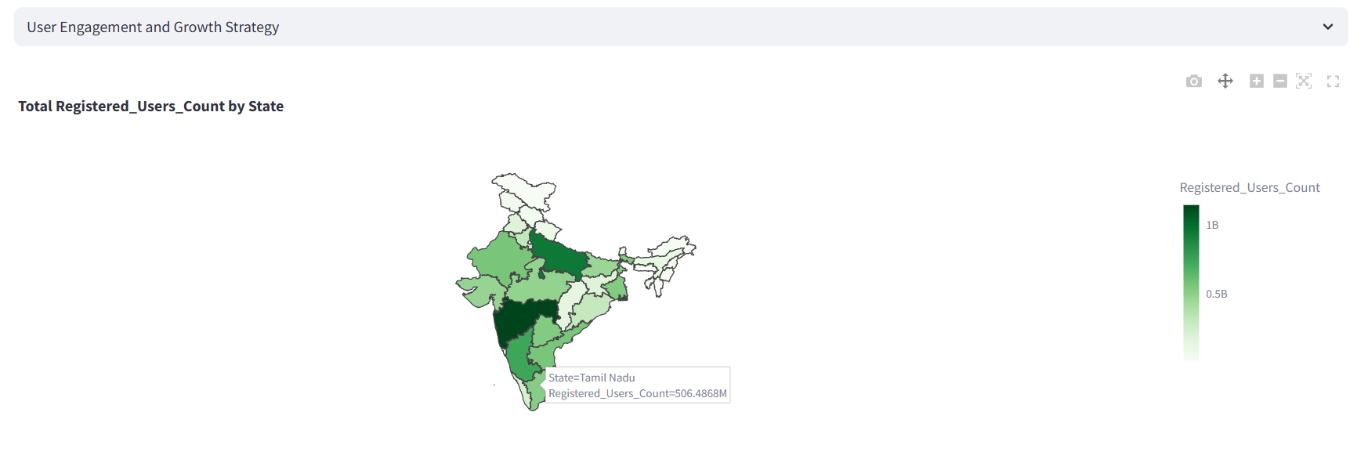
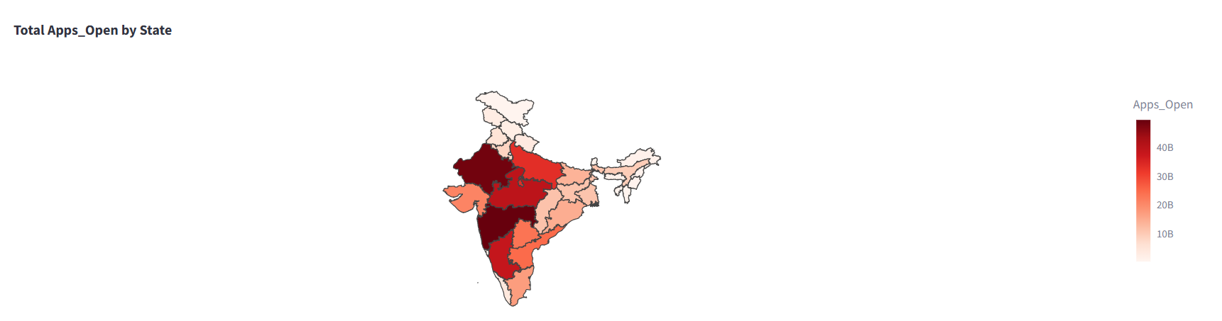
User Engagement and Growth Strategy:

Slide 20
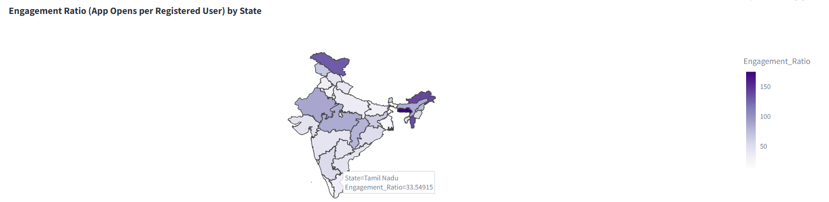
Insights:
Variation of registered users and no of people using PhonePe across states.
Can see states which have high engagement ratio, indicating highly engaged users.
Action:
States with low app opens per user should be targeted with personalized offers and regional language support.
Engage with states having high engagement ratio for better marketing and partnerships.
Analyze device and network performance metrics in low-engagement states.

Slide 21
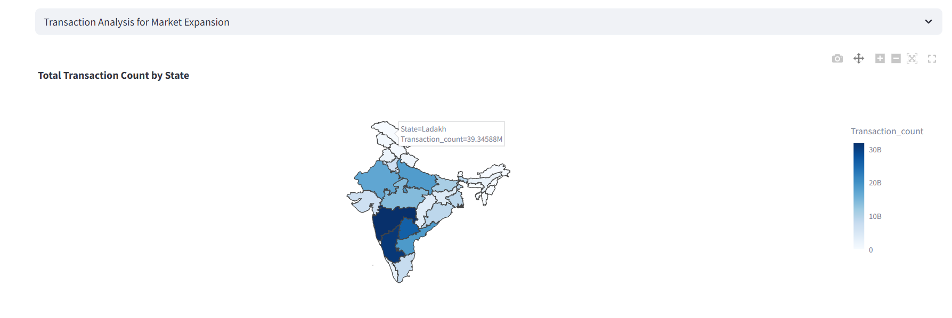
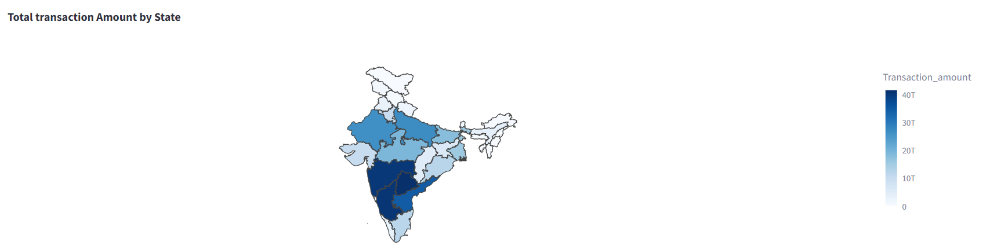
Transaction Analysis For Market Expansion:

Slide 22
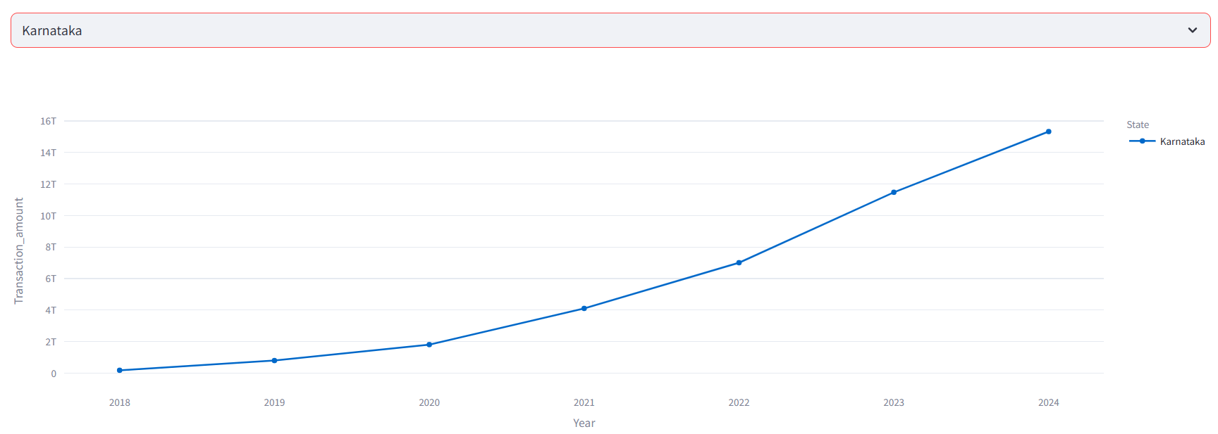
Insights:
Variation of user’s transaction count and transaction amount across states.
States with consistently increasing bars (no dips during pandemic years) show strong digital acceptance.
Can see rise in growth in amount invested for transactions after year 2020.

Slide 23
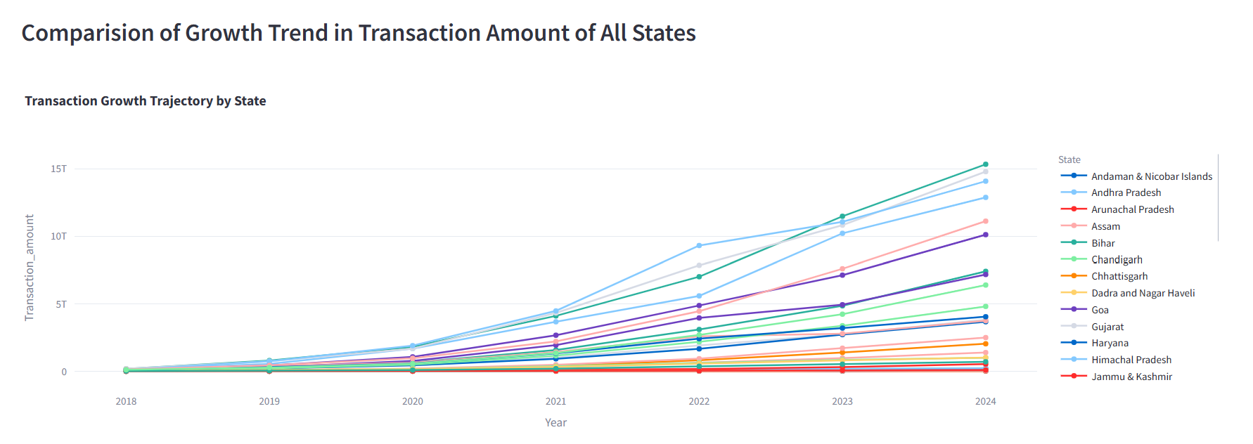
Action:
Target dormant users with push notifications or offers to reactivate usage.
Collaborate with state governments to include services like tax payments, school fee payments, and traffic challans.
Introduce or push non-UPI services like Mutual funds, gold investment, credit score tracking, FASTag recharge.
Provide offers and rewards for concurrent users.

Slide 24
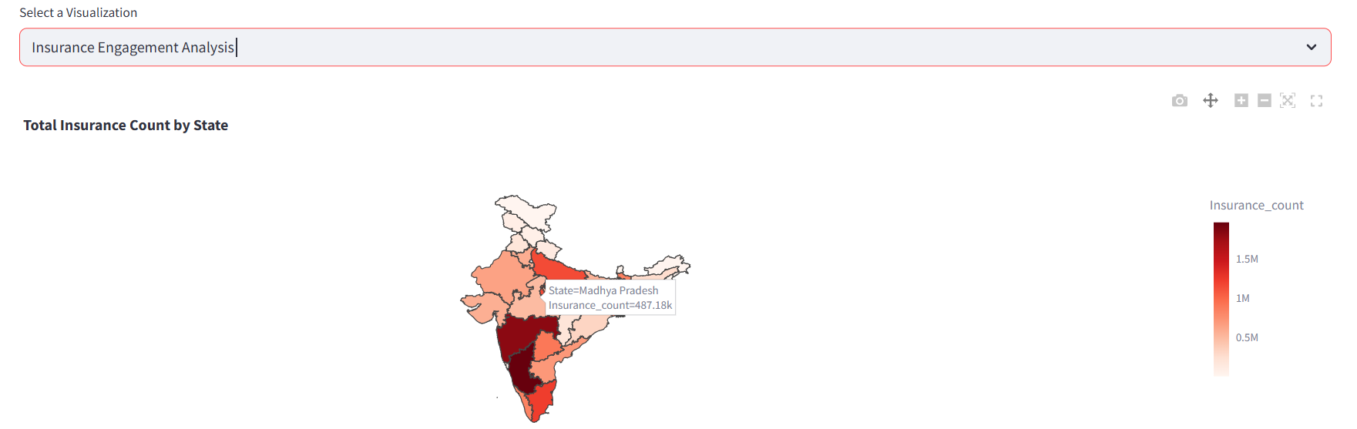
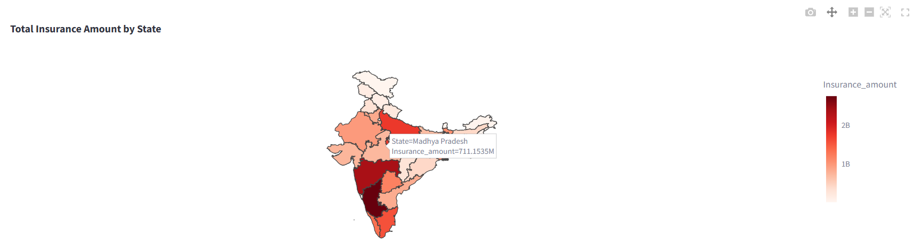
Insurance Engagement Analysis:

Slide 25
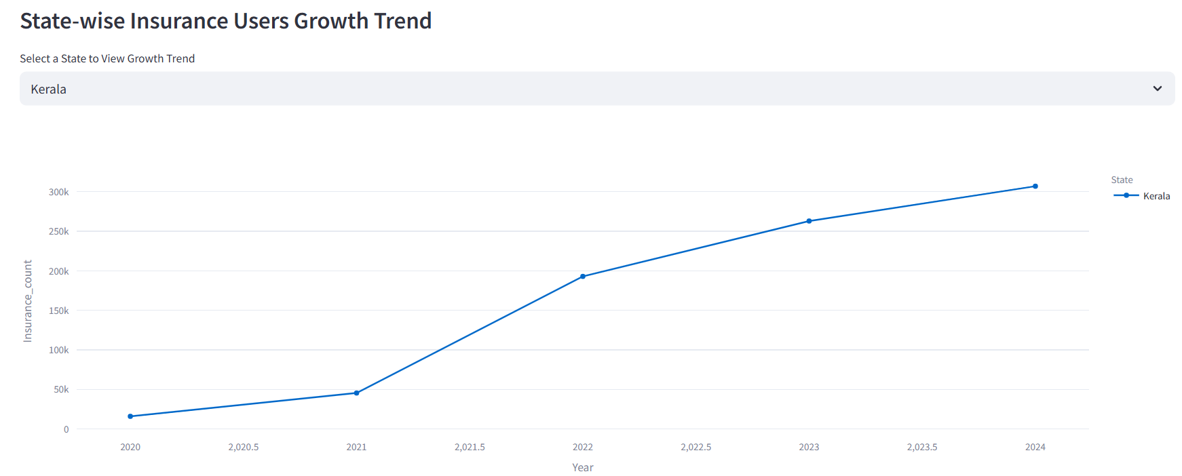
Insights:
Variation of users opting insurance and amount people invest in insurance policies devices across states.
State wise insurance users growth trend sees a increase in the year 2021.
States like Maharashtra and Karnataka show their importance in high-value insurance transactions.
PhonePe user engagement percentage provides crucial data in monitoring users with respect to population vs users.

Slide 26
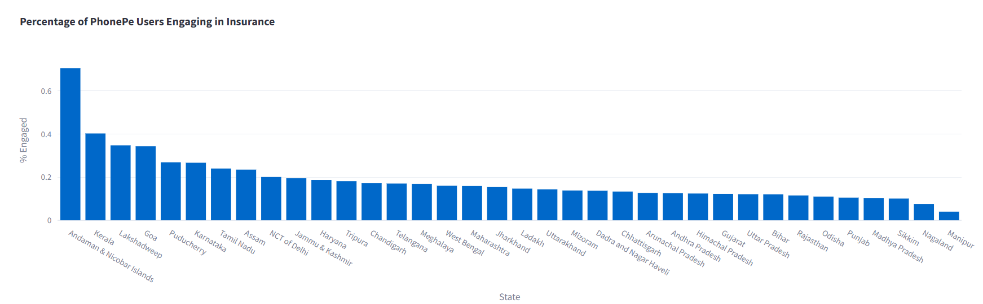
Action:
Enhance awareness campaigns in high-user but low-engagement states like Uttar Pradesh and Bihar.
Offer short-term low-premium policies tailored for users.
Offer first-time policy discounts or rewards like PhonePe cashback, vouchers, etc..

Slide 27

Conclusion:
This analysis broadens PhonePe vision based on users, type of transaction and availability of devices.
User Engagement Variability was seen where significant differences in app engagement and device usage were observed across states.
Uneven insurance statistics was seen
where states like Maharashtra and Karnataka
lead in insurance adoption, while eastern and
northeastern regions show low uptake.
On analysis of “Decoding Transaction Dynamics”,
we come to know that the platform's performance
in mature markets is stable, but expansion in
lower-tier states can unlock new user opportunities.
Overall, by converting raw transactional and user behavior data into digestible insights, this project creates a strong foundation for data-driven business expansion and user-centric innovation for PhonePe.

Slide 28
THANK YOU

